Slide 1
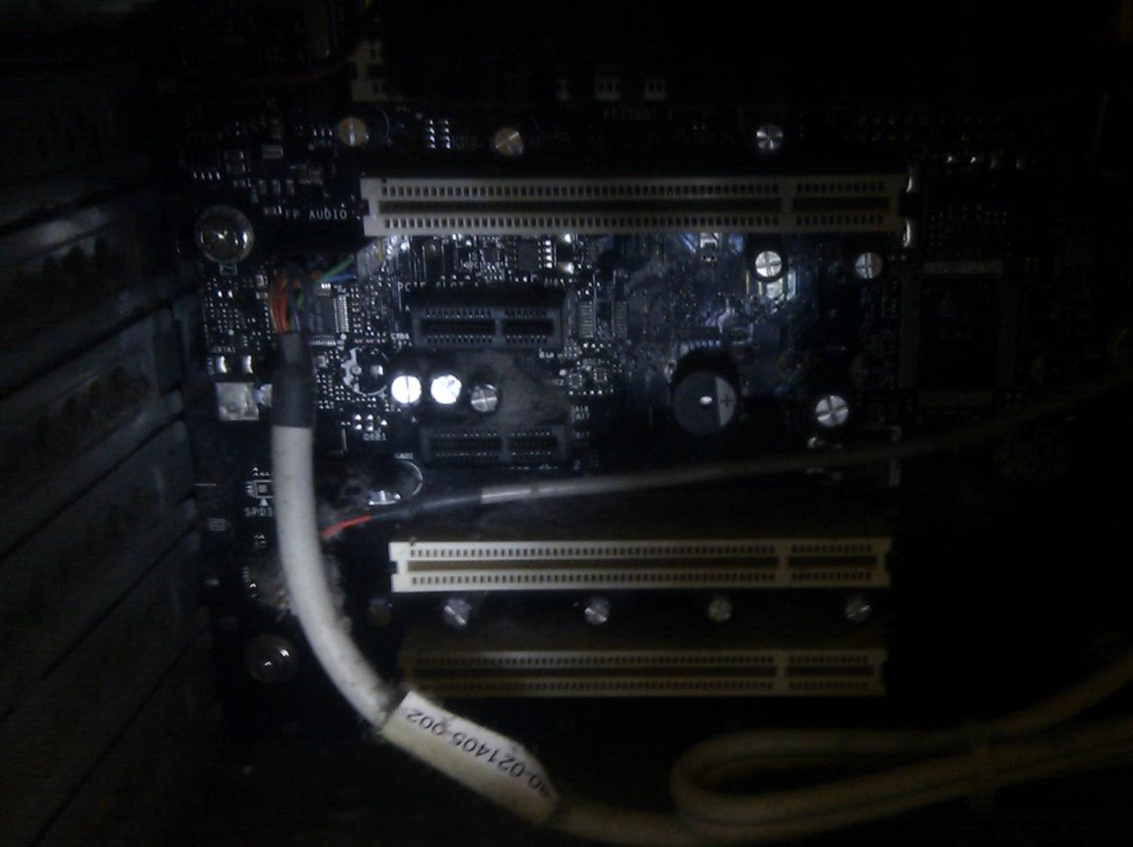

Computing Systems
Lecture 4
Compilers & Interpreters

Slide 2
Zeroes and Ones (Again, again, again)
CPU processes instructions in machine code
  Each instruction is a pattern of 1’s and 0’s
  Not easy for humans to read or write!
Assembly Languages
  Use mnemonic names for each machine code instruction
  E.g.: represents 00000101 as DEC B
  (decrease the number stored in register B by one, an instruction for the Z80 processor)
Will return to Assembly later

Slide 3
Programming In Assembly
Programming in assembly is possible
  But difficult & tied to particular CPU designs
  And very slow: very simple operations may require dozens of lines of assembly code
Hand-crafted assembly can be very efficient
  Generally not worth time & effort for the gain
  DOOM (1993) was one of the last major games to use significant amounts of hand-crafted assembly programming

Slide 4
High Level Programming Languages
Abstracted away from the low-level hardware
  More readable
  Portable – a program developed in a high-level language may be used on different CPU architectures
  More powerful: a single instruction in a high-level programming language may equate to many lines of assembly or machine code
HUGE range of high-level programming languages exist

Slide 5
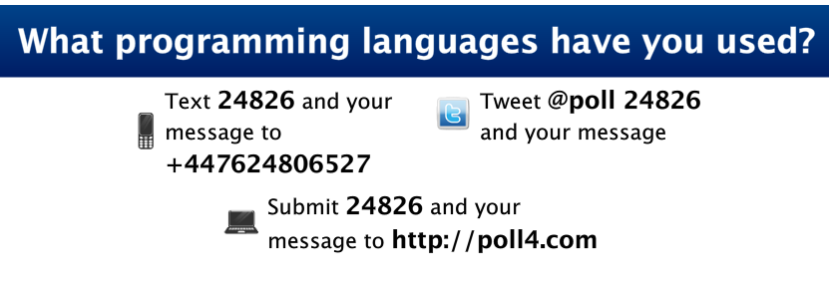
Results

Slide 6
4GL (database languages)
C++, Java, Visual Basic
C
Assembly
Machine Code

Slide 7
Language Translators
Software that converts a program from one form to another
  Most commonly from a high-level (human generated) form to a low-level (machine code) form for the computer to use
The high level language code usually exists in text files known as the source code

Slide 8
Execution Models
Models for how a program is turned from high-level code to machine code for running on a computer
Interpreted Languages
  E.g. BASIC, scripting languages
Compiled Languages
  E.g. C, C++
Translated Languages
  Code is converted to into another programming language for interpretation or compilation

Slide 9
Languages that are usually interpreted:
BASIC (most versions), Javascript, Lua, PhP, Python, Perl, Game Maker, Ruby, ...
Languages that are usually compiled:
Algol, C, C++, Objective-C, Pascal, Ada, C#, COBOL, Delphi, Eiffel, Common Lisp, Forth, Java, Scheme, Smalltalk, ML, OCaml, Visual Basic, ...

Slide 10
Interpreters
10 REM A simple BASIC program
20 PRINT “Hello World!”
30 GOTO 10
When this BASIC program is run, the interpreter converts each line in turn into machine code
Conversion to machine code occurs while the program is running

Slide 11
Language Interpretation
Can change source code at any time
Translation of instructions while program is running slows down the program
Lines inside a loop may be translated many times
Availability of the source makes it easy for others to reverse engineer your program
  Discover how your program works to make their own versions

Slide 12
Compilers
  #include <stdio.h>
  int main() {
  printf("Hello World");
  }
Before this C program can be run, a compiler must be used to convert the whole program into machine code
Conversion to machine code occurs some time before the program is run

Slide 13
C/C++ Compilation
First source code files are pre-processed
  Pre-processor instructions (directives) modify the source code itself before compilation
Next, the source code files are compiled
  A single project may have dozens or hundreds of different source code files
  The output is an object file for each source file
Finally, a linker combines all of the object files into the executable program file

Slide 14
Lexer & Parser
Lexer (lexical analyser) reads source code
  Replaces keywords with tokens
  Identifies variables and data
  Discards comments, spaces
Parser creates syntax tree from tokens
  Syntax errors detected here: where programs don’t follow the rules of the language
Syntax tree fed to a code generator stage which produces machine code
  Possibly followed by additional optimizer stage

Slide 15
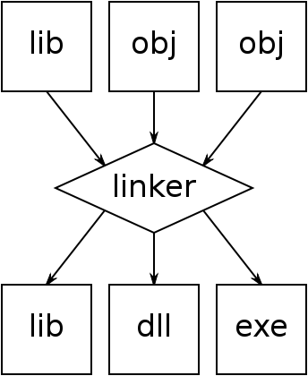
Linker
Combines object files to create executable program
Can also create dynamic link libraries – libraries of executable code to be used by other programs
Creates and uses lib files – libraries of compiled code for use in compiling other programs

Slide 16
Portable Programs
During compilation a program is translated from a high level portable form to a low level CPU specific form
  The same source code can be compiled for a range of different machines (often requiring some changes!)
Many applications need the relative speed advantage of compilation while retaining a high degree of portability

Slide 17
Bytecode and Virtual Machines
Solution may be intermediate compilation
A high-level language is compiled into a machine-code like byte-code
The byte-code is executed by a ‘virtual machine’ (VM)
The VM interprets code, translating byte-code to machine code
Java is probably the most well known example

Slide 18
Intermediate Compilation: Java
Not the same as JavaScript!
Byte-code is relatively low-level
  Does not need to be human readable
  Allows the VM to execute bytecode faster than traditional interpreted code
VMs can be developed for different platforms
  So the same Java program can run on Mac, Windows, ...
  Just-In-Time compilation to improve performance

Slide 19
Common Intermediate Language
CIL
  Part of Microsoft .Net framework
  CPU & Platform independent
  Range of languages compile to CIL
Bytecode can be translated into native code OR run by a VM
VM also uses Just-In-Time compilation
  First time a command is interpreted, it is compiled
  Repeats of a loop benefit from speed up

Slide 20
Create Your Own
Developers continue to create new programming languages
  To exploit new hardware capabilities or computer science theories
  To improve software development efficiency
  To improve on existing languages
  To prove a theoretical point
  For fun

Slide 21
LOLCODE (yes really)
Program start
HAI
CAN HAS STDIO?
VISIBLE "HAI WORLD!"
KTHXBYE
Use I/O library
Print hello world message
Program end

Slide 22
What does this program do?
HAI
CAN HAS STDIO?
I HAS A VAR
IM IN YR LOOP
  UP VAR!!1
  VISIBLE VAR
  IZ VAR BIGGER THAN 10? KTHX
IM OUTTA YR LOOP
KTHXBYE
“I HAS A” used to declare a variable
Increment variable by one
This loop will repeat until VAR = 11
Notes:
Loop to print numbers 1 to 10 – though code inspection makes it look like it will print numbers 1-11
Worth checking out...

Slide 23
Writing A Compiler
The first compilers had to be written in assembly
  There were no compilers to use!
Can use any high-level language
Range of tools exist to make it easier to write compilers
  Lex and yacc for writing lexer and parser
  Lots more at compilertools.net

Slide 24
Programming Paradigms
Over the past half century a number of different programming paradigms have emerged
Increasing complexity and size of software systems required changes to the manner of software construction

Slide 25
Imperative & Declarative
Imperative Programming
  Program is a sequence of instructions
  Each instruction changes the program state
  Procedural (or Structured) and Object-Oriented Programming
Declarative Programming
  Code declares what program should achieve, not how it should achieve it
  Functional or Logical Programming

Slide 26
Structured Programming
Examples: C, Pascal
Program can contain blocks of code known as functions or procedures
Statements may call other functions or procedures
  Execution jumps to called procedure & returns to just after calling statement when procedure is completed

Slide 27
int GetMax(int a, int b) {
if (a > b)
return a;
return b;
}
main() {
...
GetMax(input1, input2);
...
}
2. Execution jumps to here
3. Return statement ends a function
1. Program executes this statement
4. And execution continues here

Slide 28
Object Oriented Programming
Dominant programming paradigm?
Examples: C++, Java, C#, Delphi, Smalltalk
Groups data with related functions into classes and objects
  Classes encapsulate design: to use a class, there is no need to understand how it is implemented
Objects can communicate with other objects (message passing) & it is possible to derive new classes from existing ones (inheritance)

Slide 29
Functional Programming
Examples: Lisp, Scheme, Haskell
Emphasises functions where imperative programs emphasise program state
  In a functional programming language, a function’s result depends only on the input parameters, not on the program state
May be less efficient in memory & CPU use
Relatively limited use outside academia

Slide 30
Logical Programming
Examples: Prolog and variants
Based on propositional logic
Program is given a knowledge base or rules and facts
  Example fact:
  father_child(mike, tom).
  Example rule:
parent_child(X, Y) :- mother_child(X, Y).

Slide 31
Prolog Example
mother_child(trude, sally).
father_child(tom, sally).
father_child(tom, erica).
father_child(mike, tom).
sibling(X, Y) :- parent_child(Z, X), parent_child(Z, Y).
parent_child(X, Y) :- father_child(X, Y).
parent_child(X, Y) :- mother_child(X, Y).
?- sibling(sally, erica).
Yes

Slide 32
Others
Event Based
Parallel
Agent Oriented
Many other paradigms exist
  Some languages are examples of many different paradigms or may have extensions applied to enable other paradigms

Slide 33
Further Reading
Wikipedia
  Compiler, High level language, List of programming languages, LOLCODE, ...
Compilertools.net
Programming Languages and Compilers
  http://www-inst.eecs.berkeley.edu/~cs164/sp11/
  A complete course on the construction of programming languages – quite advanced

Slide 34
Next Week
Required Reading – HCW:
  RAM & Flash p56-61
  Data Storage, p148-155, p158-161, 167-171,
  177-179, 185-193
Additional Reading
  HCW – Remaining sections on Data Storage
  PCH – Chapter 12, Computer Memory

Slide 35
This work by Daniel Livingstone at the University of the West of Scotland is licensed under the Creative Commons Attribution-ShareAlike 3.0 Unported License. To view a copy of this license, visit http://creativecommons.org/licenses/by-sa/3.0/ or send a letter to Creative Commons, 171 Second Street, Suite 300, San Francisco, California, 94105, USA.
Credits:
Title Image, CC-BY-SA Daniel Livingstone
LOLCODE examples from: http://en.wikipedia.org/wiki/LOLCODE CC-BY-SA
Prolog example from http://en.wikipedia.org/wiki/Prolog CC-BY-SA
Product names, logos, brands, and other trademarks featured or referred to within the these notes are the property of their respective trademark holders. These notes have been produced without affiliation, sponsorship or endorsement from the trademark holders.

